Slide 2
Learn what is big data
Learn why should big data matter to you?
Learn about Big data and the cloud
Learn why big data in the cloud makes perfect sense
Learn Big opportunities, big challenges

Slide 3
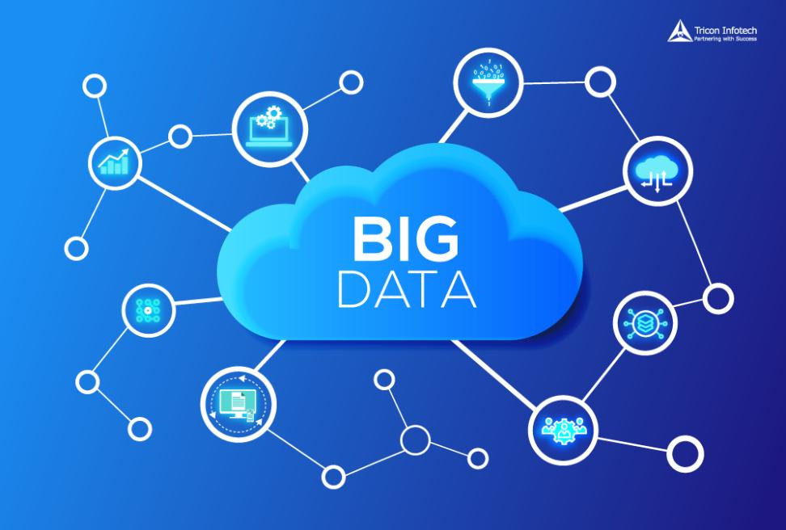
Introduction
Why Cloud Computing is the Answer to Your Big Data Initiatives

Slide 4
Introduction
What are the benefits to companies from advancement of technology?
Streamlined processes and cost-efficient operations
Availability of data from every source imaginable - social media, sensors, business applications, and many more.
Adopted cloud computing to improve their IT operations
Merging big data with cloud computing

Slide 5
What is big data?
Big Data is a collection of data that is huge in volume, yet growing exponentially with time. It is a data with so large size and complexity that none of traditional data management tools can store it or process it efficiently. Big data is also a data but with huge size.

Slide 6
The concept of big data and what it encompasses can be better understood with four Vs:
Volume
Velocity.
Variety.
Veracity.

Slide 7

Technology leaders also name a fifth V
V – value
The true value of big data can only be realized when the right information is captured and analyzed to gain actionable insights.

Slide 8
Why should big data matter to you?
An Accenture study (PDF) reveals that 79 percent of corporate executives surveyed believe that ‘companies that do not embrace big data will lose their competitive position and may even face extinction’.

Slide 9
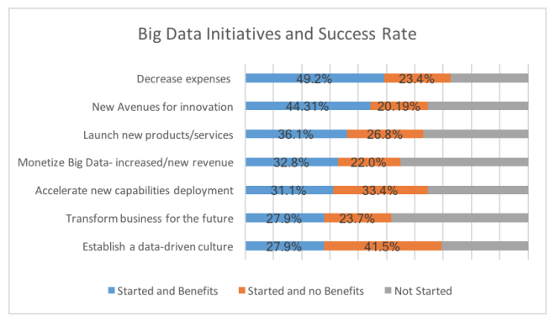
Why should big data matter to you?

Slide 10
Big data and the cloud
When your big data goes to the cloud?
Data storage
Application of basic analytics modules
Extract data at a much larger scale
Add more capacity to your in-house data warehouse or power up more servers

Slide 11
Why big data in the cloud makes perfect sense
The cloud’s scalable environment makes it possible to deploy data-intensive applications that power business analytics.
Simplifies connectivity and collaboration within an organization
It gives executives a better view of the business and boosts data-driven decision making.

Slide 12
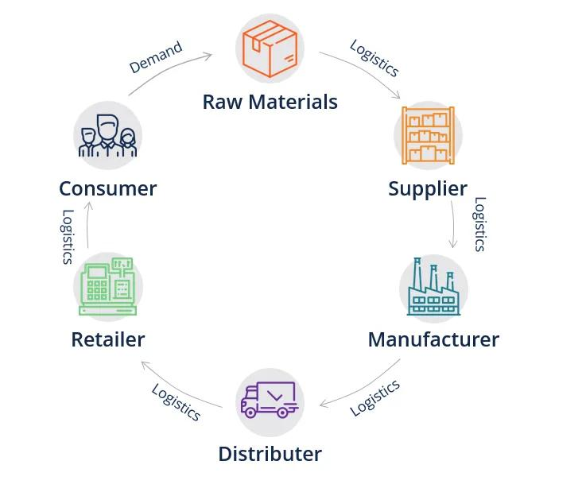
Why big data in the cloud makes perfect sense
Supply Chain

Slide 13
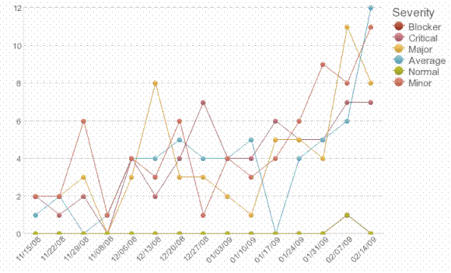
Why big data in the cloud makes perfect sense
Efficient tracking of defects

Slide 14

Why big data in the cloud makes perfect sense
Increase customer engagement and loyalty

Slide 15

Why big data in the cloud makes perfect sense

Slide 16
Why big data in the cloud makes perfect sense
Cost reduction
Revenue growth
and Strategic investments
CFO seeking new opportunities

Slide 17
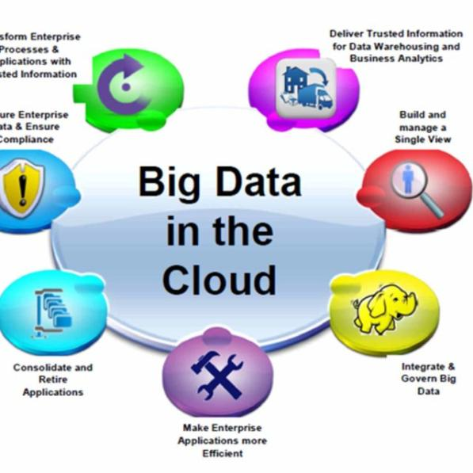
Why big data in the cloud makes perfect sense
Big data complemented with an agile cloud platform

Slide 18
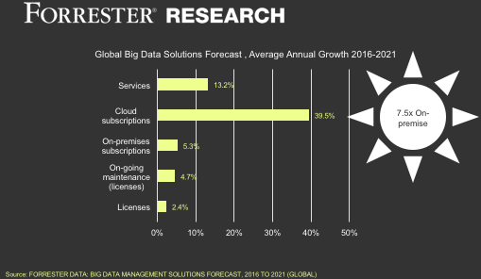
Why big data in the cloud makes perfect sense

Slide 19

Big Opportunities, Big Challenges

Slide 20
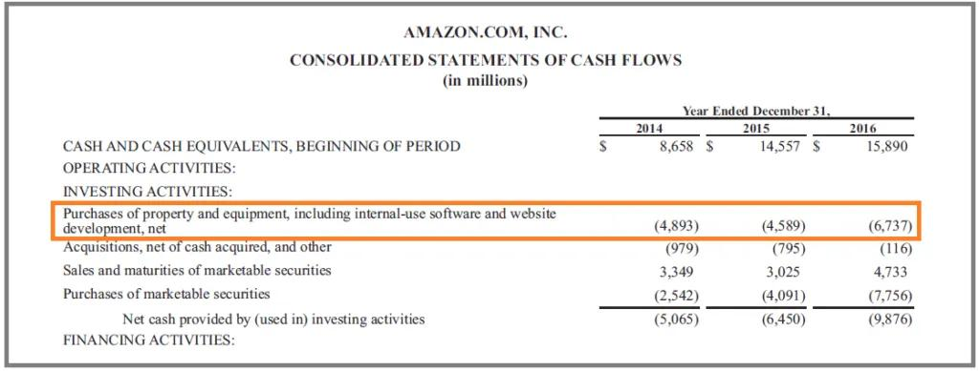
Requires zero CAPEX
The cloud has fundamentally changed IT spending as organizations know it—and in a good way.
On-premise capital expenditure (CAPEX) investments

Slide 21
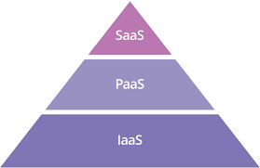
Requires zero CAPEX
Cloud’s Infrastructure-as-a-Service models

Slide 22
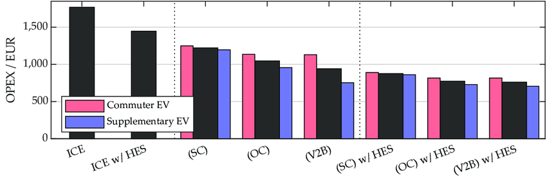
Requires zero CAPEX
Operating expenditure (OPEX) column.

Slide 23
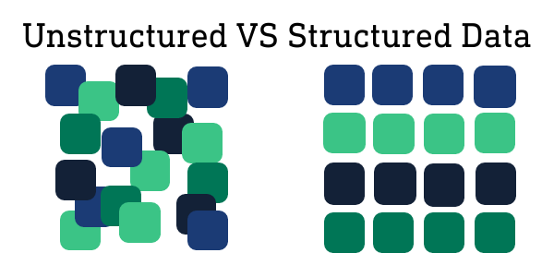
Enables faster scalability

Slide 24
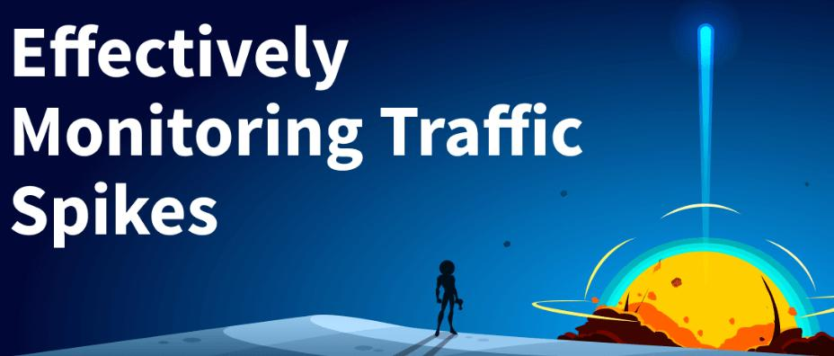
Enables faster scalability
Manage large spikes in traffic or usage

Slide 25
Lowers the cost of analytics
Mining big data in the cloud has made the analytics process less costly. In addition to the reduction of on-premise infrastructure, you can also save on costs related to system maintenance and upgrades, energy consumption, facility management, and more. You can also worry less about the technical aspects of processing big data and focus more on creating insights. Even better, the cloud’s pay-as-you-go model is more cost-efficient, with little waste of resources.

Slide 26
Lowers the cost of analytics
Analytics process less costly.
Can also save on costs
worry less about the technical aspects of processing big data
focus more on creating insights
Even better, the cloud’s pay-as-you-go model is more cost-efficient, with little waste of resources.

Slide 27
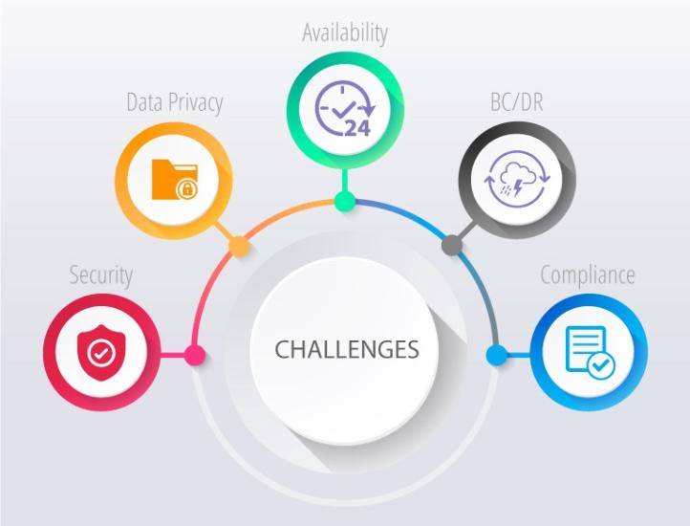
Lowers the cost of analytics
Pay-as-you-go model

Slide 28
Encourages an agile and innovative culture
Cultivated within any enterprise
Creative ways of using big data to gain a competitive advantage
Focuses on analyzing data instead of managing servers and databases, you can more easily and quickly unearth insights

Slide 29

Enables better business continuity and disaster recovery

Slide 30

Enables better business continuity and disaster recovery

Slide 31
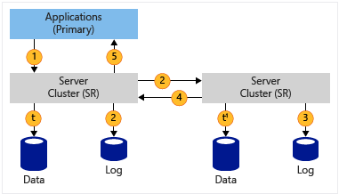
Enables better business continuity and disaster recovery
The task of replicating a data center – with duplicate storage, servers, networking equipment, and other infrastructure – in preparation for a disaster is tedious, difficult, and expensive

Slide 32
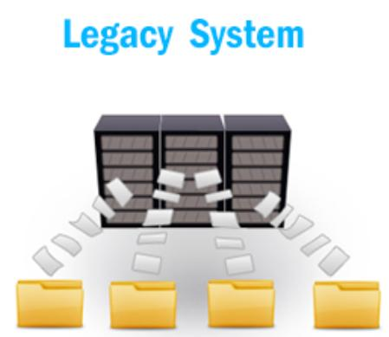
Enables better business continuity and disaster recovery
Legacy systems often take very long to back up and restore. This is especially true in the era of big data, when data stores are so immense and expansive.

Slide 33
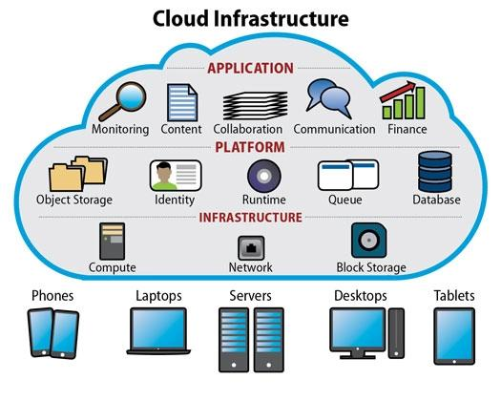
Enables better business continuity and disaster recovery

Slide 34
Potential challenges of big data in the cloud

Slide 35

Potential challenges of big data in the cloud

Slide 36
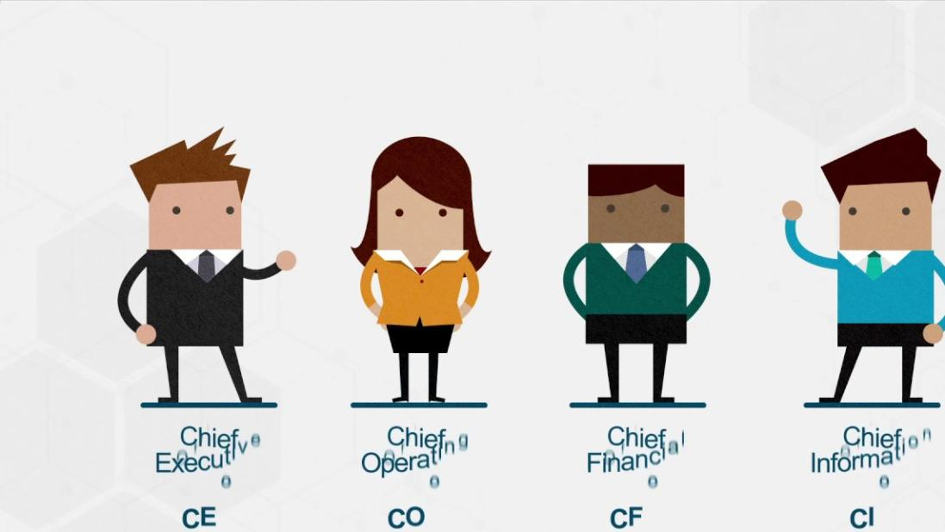
Potential challenges of big data in the cloud

Slide 37
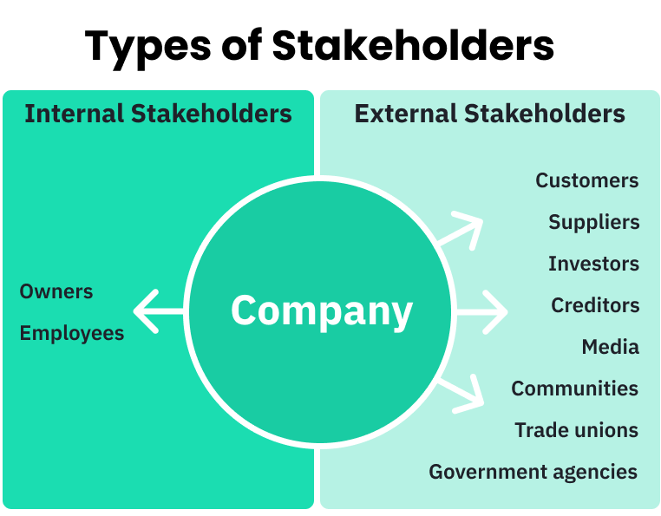
Potential challenges of big data in the cloud
Business Stakeholders

Slide 38

Less control over security
Sensitive information

Slide 39
Less control over security
Individuals’ addresses

Slide 40
Less control over security
Individuals’ addresses
Credit card details

Slide 41
Less control over security
Individuals’ addresses
Credit card details
Social security numbers

Slide 42

Less control over security
Data breaches

Slide 43

Less control over security
Loss customers and revenue

Slide 44

Less control over security
less direct control over your data,

Slide 45

Less control over security
Security should not be a hindrance

Slide 46
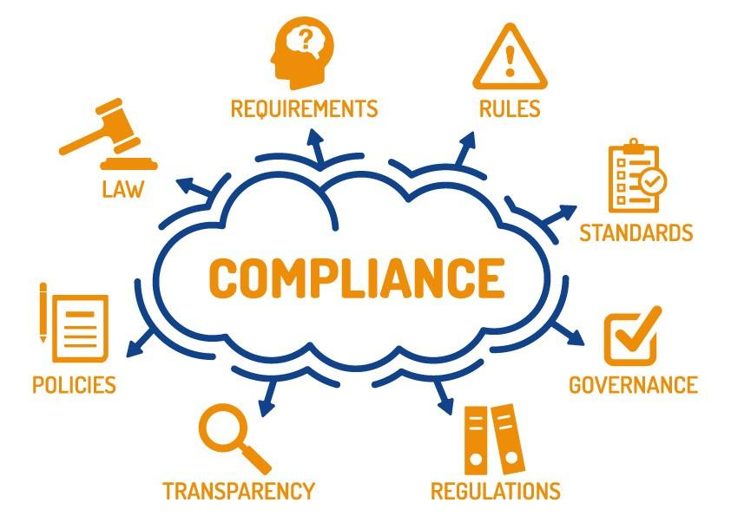
Less control over compliance

Slide 47
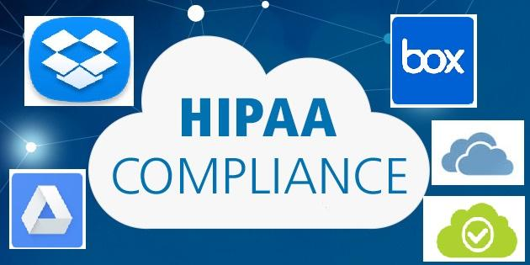
Less control over compliance

Slide 48
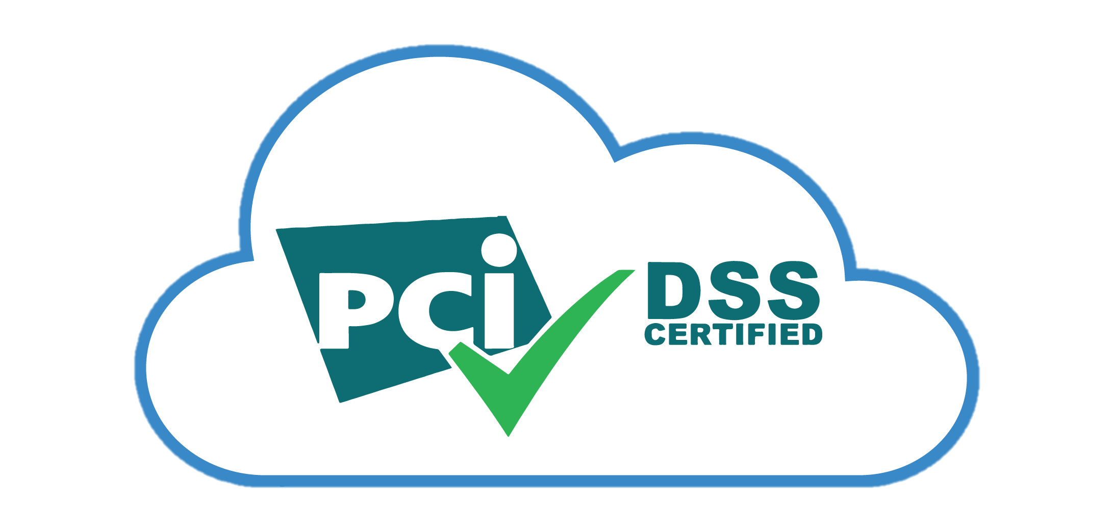
Less control over compliance

Slide 49
Less control over compliance
Even if your CSP is managing a good chunk of your compliance, you should make sure you know the answers to the following questions:
  Where is the data going to reside?
  Who is going to manage it, and who can access it?
  What local data regulations do I need to comply with?

Slide 50
Less control over compliance
Make sure you know exactly
  what data is stored where,
  ensure that your CSP has robust compliance policies,
  understand the shared responsibility model,
  potentially create Service Level Agreements (SLAs) for compliance.

Slide 51
Network dependency and latency issues
Availability of the data is highly reliant on network connection
System could be prone to service interruptions.
Volume of data that’s being transferred, analyzed, and processed at any given time.

